Slide 1
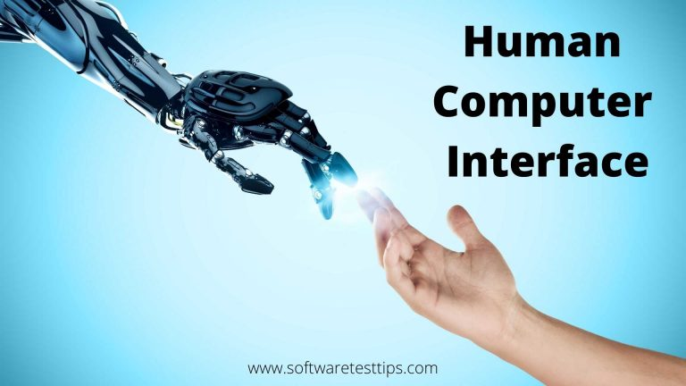
Lecture # 01 & 02

Slide 2
Course Details
Credit Hours : 3(3+0)
Pre-requisites : Software Engineering
Recommended Book:
Human Interaction, Emerging Technologies and Future Applications III: Proceedings of the 3rd International Conference on Human Interaction and ... in Intelligent Systems and Computing, 1253) 1st ed. 2021 Edition
D. Benyon, Designing Interactive Systems: A Comprehensive Guide to HCI, UX and Interaction Design, 4th edition, Pearson, 2019. 3. **A. Dix et al., Human Computer Interaction, 3rd Edition, Pearson Education, 2003.

Slide 3
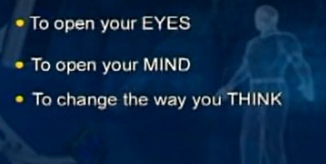
Mission

Slide 4
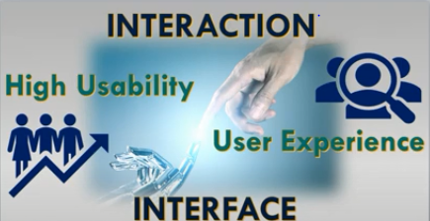
Notes:
human and computer interaction with some gestures ..
what ever the human input that is became user’s input to computer. And it with react or display recults on that
lets work on two e.g Iphone Android.
they are eaisy to use…..
even kids can use that

Slide 5
Definition of HCI
HCI is the study of interaction between people (users) and computers
Human-computer interaction is a discipline concerned with the design, evaluation and implementation of interactive computing systems for human use and with the study of major phenomena surrounding them.
Notes:
Interaction is important : human should feel that it is easy to use this computer.

Slide 6
Importance of HCI
Usable and efficient Interaction with different computing devices
*Translates to higher productivity in any industries
Simple Aesthetic Appeal of an interface, while satisfying the need for usability
*Is now a critical requirement for systems commertially
Notes:
as we are seeing Sw industry ans ages are evolving so the importance of HCI grows.
At the time of main frame very limited people access the computers there were Cli interface there is difficulty for using ..
no devices and computer are every where u r using mobile…. It is so usable … simple friendly interface soo it is very important
To develop those devices with good interface and
This is done by studyng HCI

Slide 7
UX : user experience
The overall experience of a person using a product such as a website or computer application, especially in terms of how easy or pleasing it is to use.
"if a website degrades the user experience too much, people will simply stay away"
Ux is no UI
UI = look+feel (only the design of your system)
UX = look+feel +usability(how much it is eaisy to use.. E.g. how much time it saves in using system)
Notes:
Wht u see on screen what u interact wd = UI.

Slide 8
USER INTERFACE
System users often judge a system by its interface rather than its functionality
A poorly designed interface can cause a user to make catastrophic errors
Poor user interface design is the reason why so many software systems are never used
Notes:
Interface eaisy means eaisy to use. Poor difficult to use ther is more chance of error due to lack of under standing.

Slide 9
GRAPHIC USER INTERFACE
Most users of business systems interact with these systems through graphical interfaces although, in some cases, legacy text-based interfaces are still used

Slide 10

Principal of HCI
Know the User
Task refers to the job to be accomplished by the user with interactive by the user with the interactive system
Notes:
As the user is the one who is going to use sw or system so we should knw about it abilities , to see weather he is tht capable to use system

Slide 11
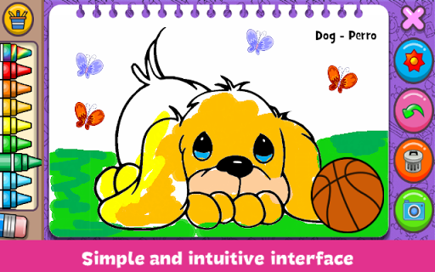
Know the User
A sample webpage for kids
Colorful
Looks Fun
With characters
Use simple words
Overall Creative
Notes:
For kids interface need to be color ful , for adult it needs to be sober

Slide 12

Principal of HCI
Reduce Memory Load
Humans are more efficient in performing tasks that require light memory load
Notes:
Interface need to be so eaisy and usable that human do not need to put load on memory or brain

Slide 13
Principal of HCI
Strive for Consistency
Leads to higher Satisfaction and preference while using system
Notes:
Continues satisfaction is necessary after using systems. Experience not need to be degraded. Consistency should be there

Slide 14
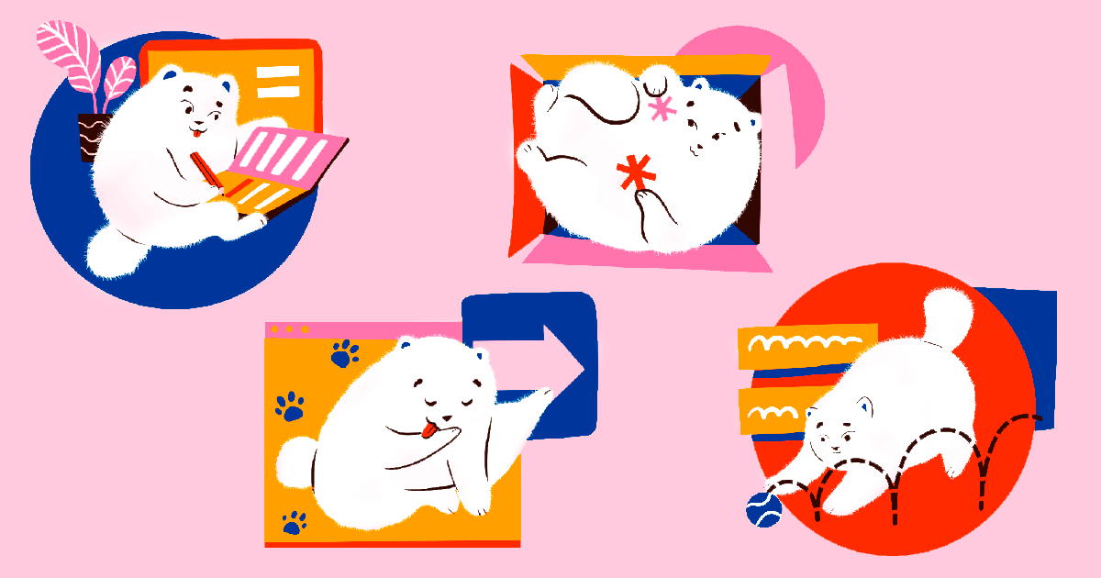
Principal of HCI
Prevent Errors/Reversal of Action
It is important to complete the task without any error

Slide 15
Norman's 7 Principles
Use both knowledge in the world and knowledge in the head.
Simplify the structure of tasks.
Make things visible: bridge the gulfs of Execution and Evaluation.
Get the mappings right.
Exploit the power of constraints, both natural and artificial.
Design for error.
When all else fails, standardize.
Notes:
The knwlge in world and head should be used: for e.g u are given a task and u don’t have idea in your brain and there is nothing on net so it is difficult to solve. But eavery task is not like that sooo , they are saying k use every possible knwlege tht you have or in world or net so tht u can solve it eaisyly.
2. Simply the task into smaller and solve the smaller decomposed task
Make the phases visible : task is visible , task is in progress , task is completed ( the impact of task is visible to user ) not in guessing mode
Mappin right : switches of lights. Proper functions mapping to right switch ( numbers on swith will be good mapping)…
icons , graphics are used for good mapping… for folders file icon ,, for shopping cart basket icon
5. There are some constrains/ limitations for some tasks. The constrains and limitation are define clearly unambiguous , only one meaning not more than one meaning.
6. If there is error , we should not punish error , ther must be recovery or alternatives for e.g undo example or roll back.
7. When every 6 things failz make things standardizations….. Not user learn standard and it can wrork on different system with same standard basic

Slide 16
Understand the Task
Invoke Internet Browser
Enter Password
Novice User
Wireless LAN Setup
Select Access Point (AP)
Enter Password
Invoke Internet Browser
Show AP
Expert User

Slide 17
SUCCESS OF SOFTWARE-HCI
With the exception of some embedded software and operating system code, the success of a software product is determined by the humans who use the product
Notes:
Human is main part for interactions we can say.. We need to understand human,
Every thing is for human , like eaisy to use for users, user centeric
HCI is evolutionary development…
You make something … run goo back take feedback and development new requirements. Here mostly in HCI design requirements are not complete.

Slide 18
Why HCI is Important
HCI can assist in building product/system that are:
-Useful, accomplish what require
-Usable, do it easily and naturally
Used, make people want to use it
-Increasing Participation
-Ensuring interfaces and systems are accessible
Performance is depending on UX tht comes from good ui design so it involved HCI.
Notes:
HCI helps to make system which are easy to interact with.
Usable
Easy to interact
Make the system by understanding users who are going to use system

Slide 19
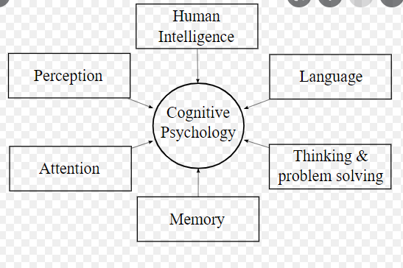
Cognitive Psychology
A sub discipline of psychology exploring internal mental process
Is the study of how people perceive, remember think speak and solve problem
Notes:
Its is related to HCI as, it is process to understand user thinking process that how he is going
To understand and percieve the system. What he thinks when
he saw system what input he can give so we can made systems like wise

Slide 20
Cognitive psychology is the branch of psychology that deals with motivation, problem-solving, decision-making, learning, memory, and more

Slide 21
INPUT-OUTPUT CHANNEL
A person’s interaction with outside world with anything may it be system or others
Occur through information being perceived and sent :input and output
There are five major senses
Sight
Hearing
Touch
Taste
Smell
Notes:
Good design vs bad design : extreme brightness , poor colors and bad icons

Slide 22
User-centred design
User-centred design is an approach to UI design where the needs of the user are paramount and where the user is involved in the design process
UI design always involves the development of prototype interfaces
Notes:
User is part of whole design process , we will get feed back from users.. Immediate feedback and improve our product

Slide 23
User centered design process
Professional resource to creating software with functionality that users need. However, the availability of technical functionality does not guarantee that software will be practically usable.
Notes:
To use Professional resource to creating software with functionality that users need.

Slide 24
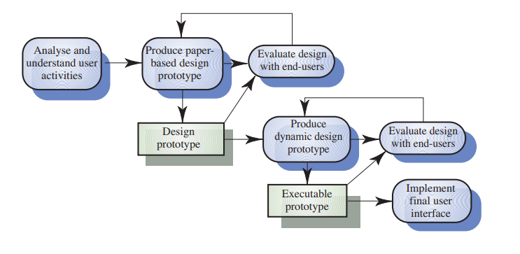
User Interface Design Process
Notes:
Understaing user and its task its environment and
Understanding the users and its context why and when they perform task
making solutions for that user on the base of requirements
Making prototypes.(a sample of your system , an erliar version of your systems.)
Evaluate design with end user (the best way is usability testing… how eaisy is for users. (usability, context, requirement… we check that each and eevery thing is fine we say tht it is good design).
Ifff any thing is not right or any requirement is not satisfied it wll repeat or go back.
5. Making working prototypes. And take feed back on user after that make final interface designs.
Thinking in other way user is also a limitation here … if there are diffent culture and many users.

Slide 25
UI design principles
UI design must take account of the needs, experience and capabilities of the system users
Designers should be aware of people’s physical and mental limitations (e.g. limited short-term memory) and should recognise that people make mistakes
UI design principles underlie interface designs although not all principles are applicable to all designs
Notes:
Kids website will be color full and with basic options..
But a website for office user will be some subtle colors and specific options.
Similarly..
Apps

Slide 26
User interfaces are the access points where users interact with designs. They come in three formats:
Graphical user interfaces (GUIs)—Users interact with visual representations on digital control panels. A computer’s desktop is a GUI.
Voice-controlled interfaces (VUIs)—Users interact with these through their voices. Most smart assistants—e.g., Siri on iPhone and Alexa on Amazon devices—are VUIs.
Gesture-based interfaces—Users engage with 3D design spaces through bodily motions: e.g., in virtual reality (VR) games.

Slide 27
USABILITY
Usability is a quality attribute that assesses how easy user interfaces are to use.
The word usability also refers to methods for improving ease-of-use during design process

Slide 28
Why usability is important
Usability is a necessary condition for survival If a website is difficult to use, people leave If the home page fails to clearly state what a company offers and what users can do on the site, people leave.
If users get lost on a website, they leave If a website's information is hard to read or doesn't answer users' key questions, they leave
Notes:
Usability is important for survival and existence of any software or website or app

Slide 29
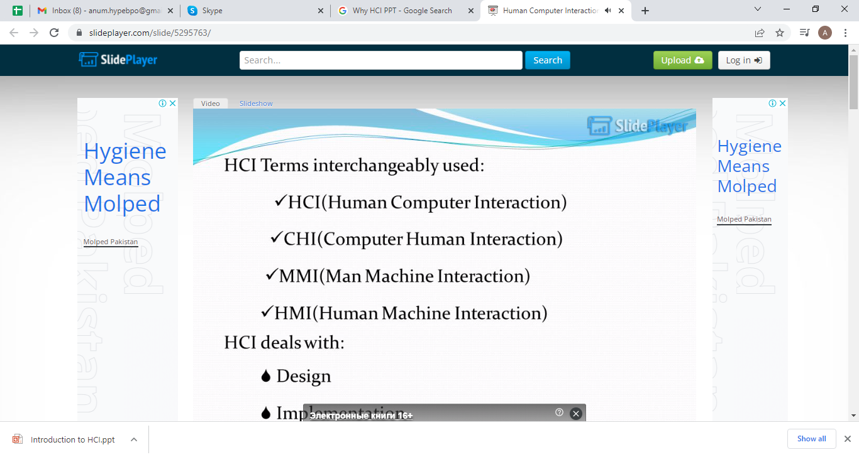

Slide 30
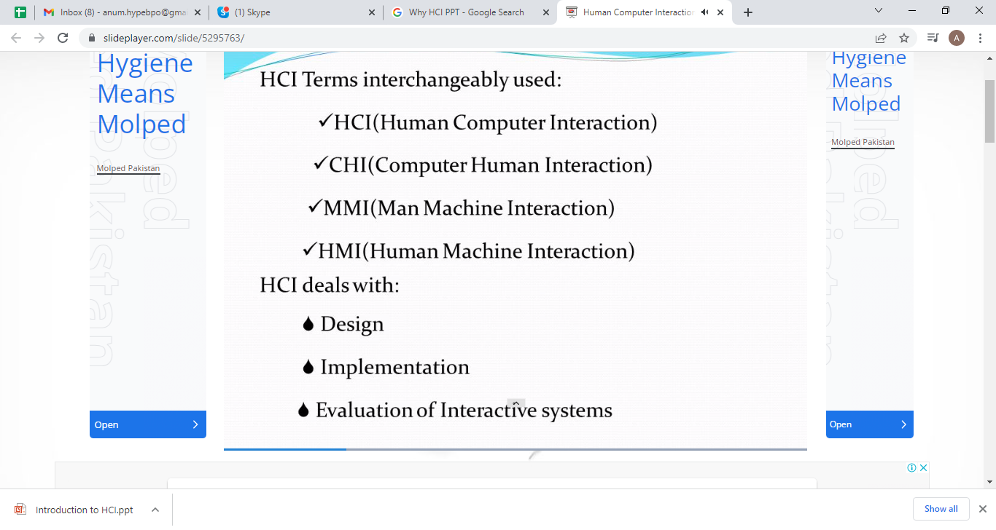
Notes:
In HCI there are 2 big parts(in term of development)
Design
Technology

Slide 31
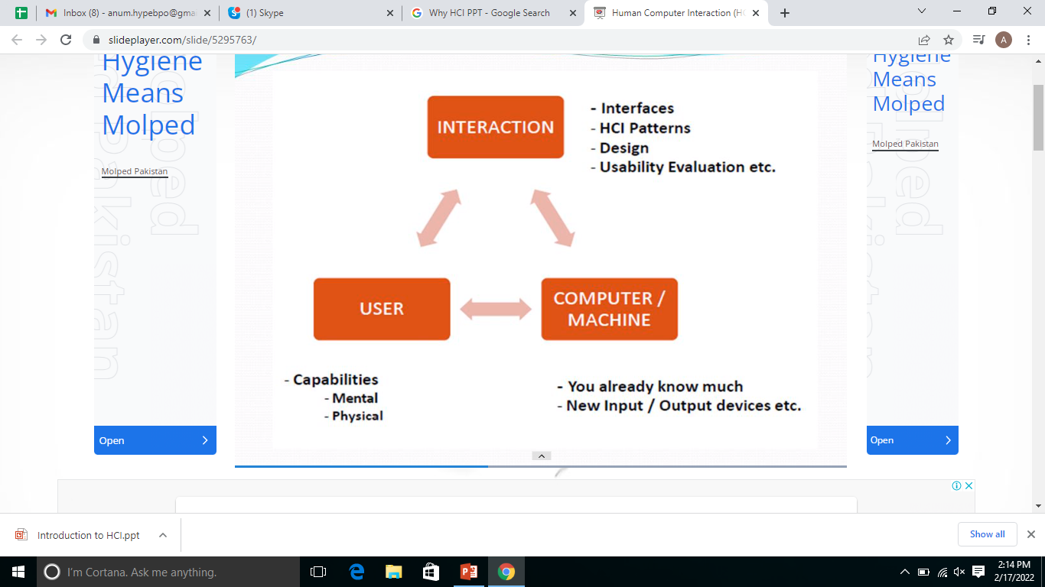
Notes:
User : we should now the capabilities and limitations of users.
Machine : we should now the functions/capabilities and limitations of users.

Slide 32
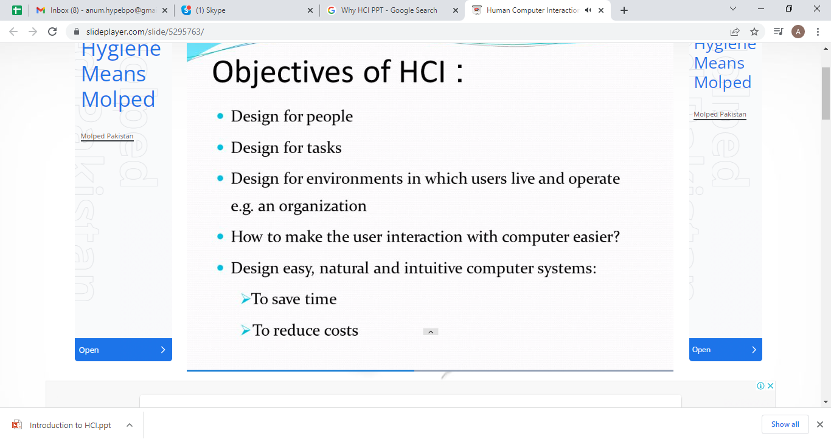
Notes:
Not to make brain tired.

Slide 33
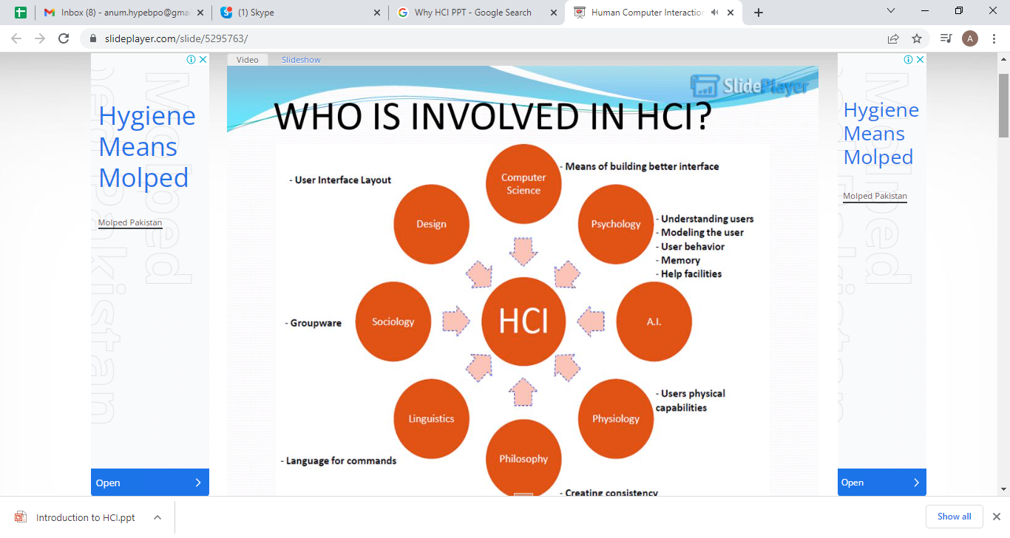

Slide 34
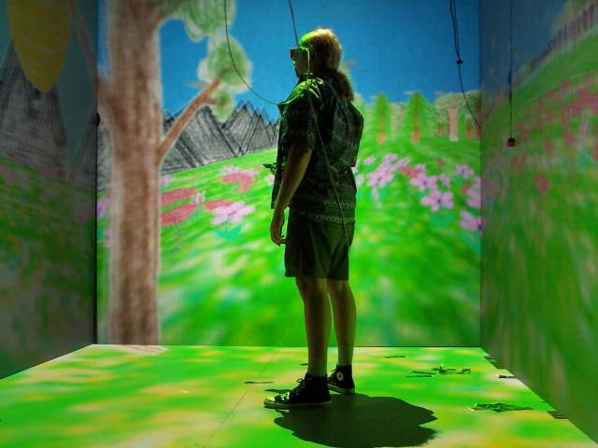
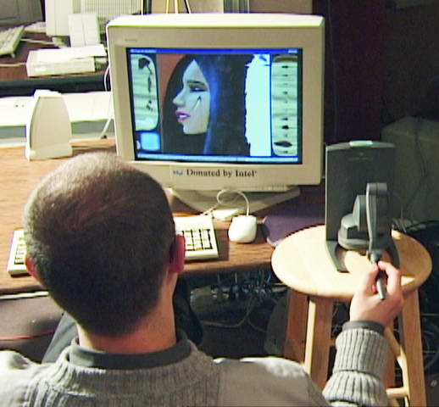
HCI Tools
Sound
3D
Animation
Video
Devices
Size (small->very large)
Portable (PDA, phone)
Plasticity
Context sensitive/aware
Personalizable
Notes:
There are different types of devices
people are moving towards personalization that is why HCI tools help to provide better interaction for each diffent user

Slide 35
HCI TOOL
These tools are primarily divided into four categories:
interface design
interface usability
web design
web usability
These categories reflect more the tasks of designers and developers rather than the divisions of information.
Notes:
e.G prototyping tool
web designing tools
ect

Slide 36
HCI Goals
Influence academic and industrial researchers
Understand a problem and related theory
Hypothesis and testing
Study design (we’ll do this!)
Interpret results
Provide tools, techniques and knowledge for commercial developers
competitive advantage (think ipod)
Raising the computer consciousness of the general public
Reduce computer anxiety (error messages)
Common fears:
I’ll break it
I’ll make a mistake
The computer is smarter than me
HCI contributes to this!
Notes:
Reduce computer anxiety (error messages) after using devices
Provide tools, techniques and knowledge for commercial developers to make better interactive designs.

Slide 37
Interactive Systems
Interactive systems are computer systems characterized by significant amounts of interaction between humans and the computer.
Most users have grown up using Macintosh or Windows computer operating systems, which are prime examples of graphical interactive systems.
Notes:
Which provide maximum best interaction to user while using systems.

